Slide 1
Memory Banking in Microprocessor
Farhan Sadaf
Lecturer, Dept. of CSE

Slide 2
Memory Banking
The 8086 processor provides a 16-bit data bus. So It is capable of transferring 16 bits in one cycle.
But each memory location is only of a byte(8 bits), therefore we need two cycles to access 16 bits(8 bit each) from two different memory locations.
Through Memory banking, our goal is to access two consecutive memory locations in one cycle(transfer 16 bits).

Slide 3
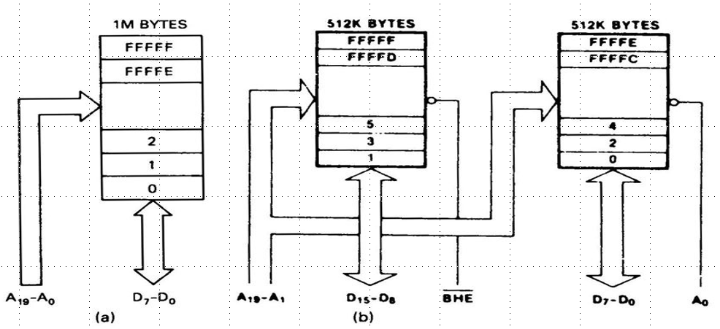
Memory Banking (Cont.)
The memory is equally divided into two parts(banks).
Even bank (Lower Bank): Contains even addresses.
Odd bank (Higher Bank): Contains odd addresses.

Slide 4
Memory Banking (Cont.)
Only 19 bits can be used for addressing (A₁ to A₁₉).
A₀ is used for enabling / disabling the even bank.
BHE is used for enabling / disabling odd bank.
BHE | A₀ | Type of transfer
0 | 0 | 16-bit data transfer from both Odd and Even Banks
0 | 1 | 8-bit data transfer from Odd Bank
1 | 0 | 8-bit data transfer from Even Bank
1 | 1 | None (Idle)

Slide 5
Memories starting at even address take 1 cycle and odd address 2 cycles
When 16 bit memory having starting at even location (say 4) is addressed, both 4 (A₀₋₂₀=0000… 0100) and 5 (A₀₋₂₀=0000… 0101) are simultaneously enabled as A₁₋₁₉ (0000…010X) are considered.
Suppose we need to fetch data from 4th and 5th address (starting at even address), thus read/write operation can be done simultaneously in a cycle.
But in case first memory cycle is 5th and we need to fetch data from 5th and 6th address (starting at odd address), only odd bank is enabled in the first cycle. And the even bank is enabled in second cycle. Thus taking 2 cycles for read/write.

